Slide 1
Implications of DNS Encryption
Geoff Huston
APNIC Labs

Slide 2
A Traditional View of the DNS
The DNS is part of shared common infrastructure services
Application
Recursive
Resolver
Authoritative Servers
Platform
Stub Resolver
Local ISP

Slide 3
The Rise of Open Resolvers
The DNS as a service overlay
Application
Local ISP
Authoritative Servers
Platform
Open Recursive
Resolver
Stub Resolver

Slide 4
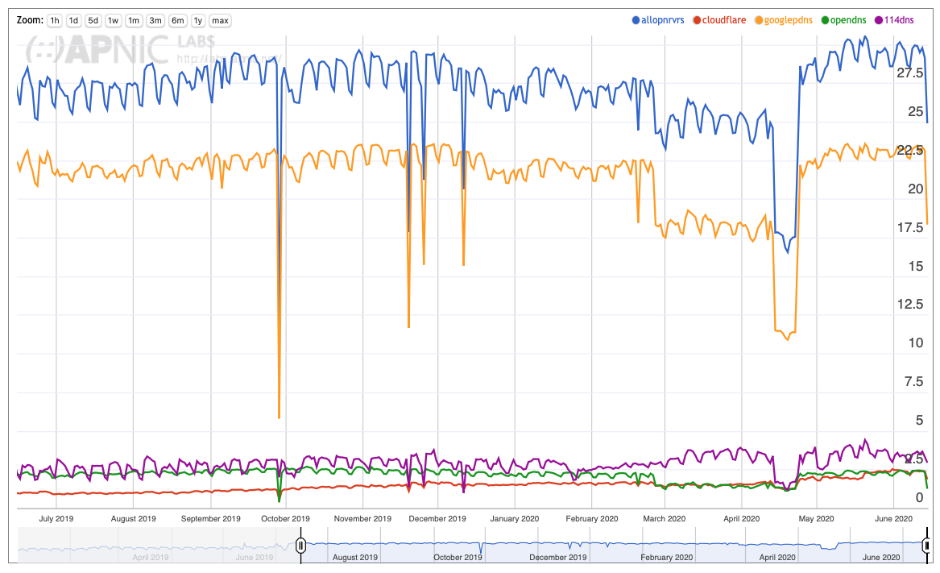
Use of Open Resolvers
More than a quarter of the Internet’s users send queries to open resolvers
Google is the dominant provider with 22% market share
https://stats.labs.apnic.net/rvrs

Slide 5

Opportunities for Interception
The DNS as a service overlay
Application
Local ISP
Authoritative Servers
Platform
Open Recursive
Resolver
ECS
leaks
Stub Resolver
resolver
leaks
transit
interception
ISP
interception
Platform Leaks

Slide 6
Opportunities for Interception
DNS over TLS
Application
Local ISP
Authoritative Servers
Platform
Open Recursive
Resolver
ECS
leaks
Stub Resolver
resolver
leaks
transit
interception
ISP
interception
Platform Leaks

Slide 7
Sealing it up
Open DoX
Recursive Resolver
Application
Local ISP
Authoritative Servers
Platform
Open Recursive
Resolver
Stub Resolver

Slide 8
Application Specific Name Services?
?
Application-specific Name Servers
Application
Local ISP
Authoritative Servers
Platform
Open Recursive
Resolver
Stub Resolver

Slide 9
Futures?
The DNS appears to be receding as a common infrastructure
DoH / DoQ are pushing the name space to become an application capability
It’s possible that the other end of the encrypted tunnel becomes an application-specific name service rather than generic DNS
From such application-specific platforms its possible that application-specific name services are used
  Name “pushing”
  Customised “names”
  Other bright ideas!
At that point the coherency of the name system is placed under pressure and fragmentation of this space becomes more likely

